Slide 1
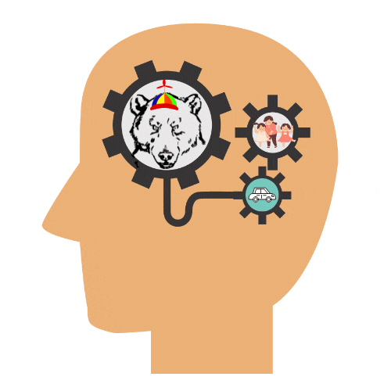

Semantic Representation of Human vs Vehicles in the Brain
By: Jon McGill, Atharva Kand, Ceri Ngai, Ernest Kirubakaran Selvaraj
(aka Scholarly Bears)

Slide 2


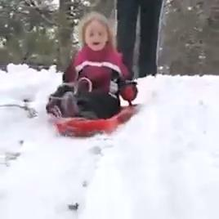

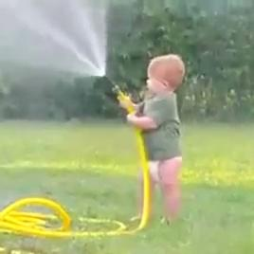

Research Questions & Approach
Humans are usually able to differentiate between animate and inanimate objects in everyday life (cf. Huth, Nishimoto, Vu, Gallant, 2012)
Questions
How are these different categories of information represented in the brain?
Which region(s) of the brain might be responsible for distinguishing between humans and vehicles?
Dataset
Algonauts 2021
Approach
Data: labelling humans VS vehicles videos from Algonauts dataset
RDM: computing the difference between humans & vehicles video
RSA: exploring correlations between RDM & 9 brain regions
Searchlight: localising brain regions that help discriminate humans & vehicles
Algonauts Challenge Dataset 2021
Semantic Representation of Humans VS Vehicles
Scholarly Bears
‹#›

Slide 3
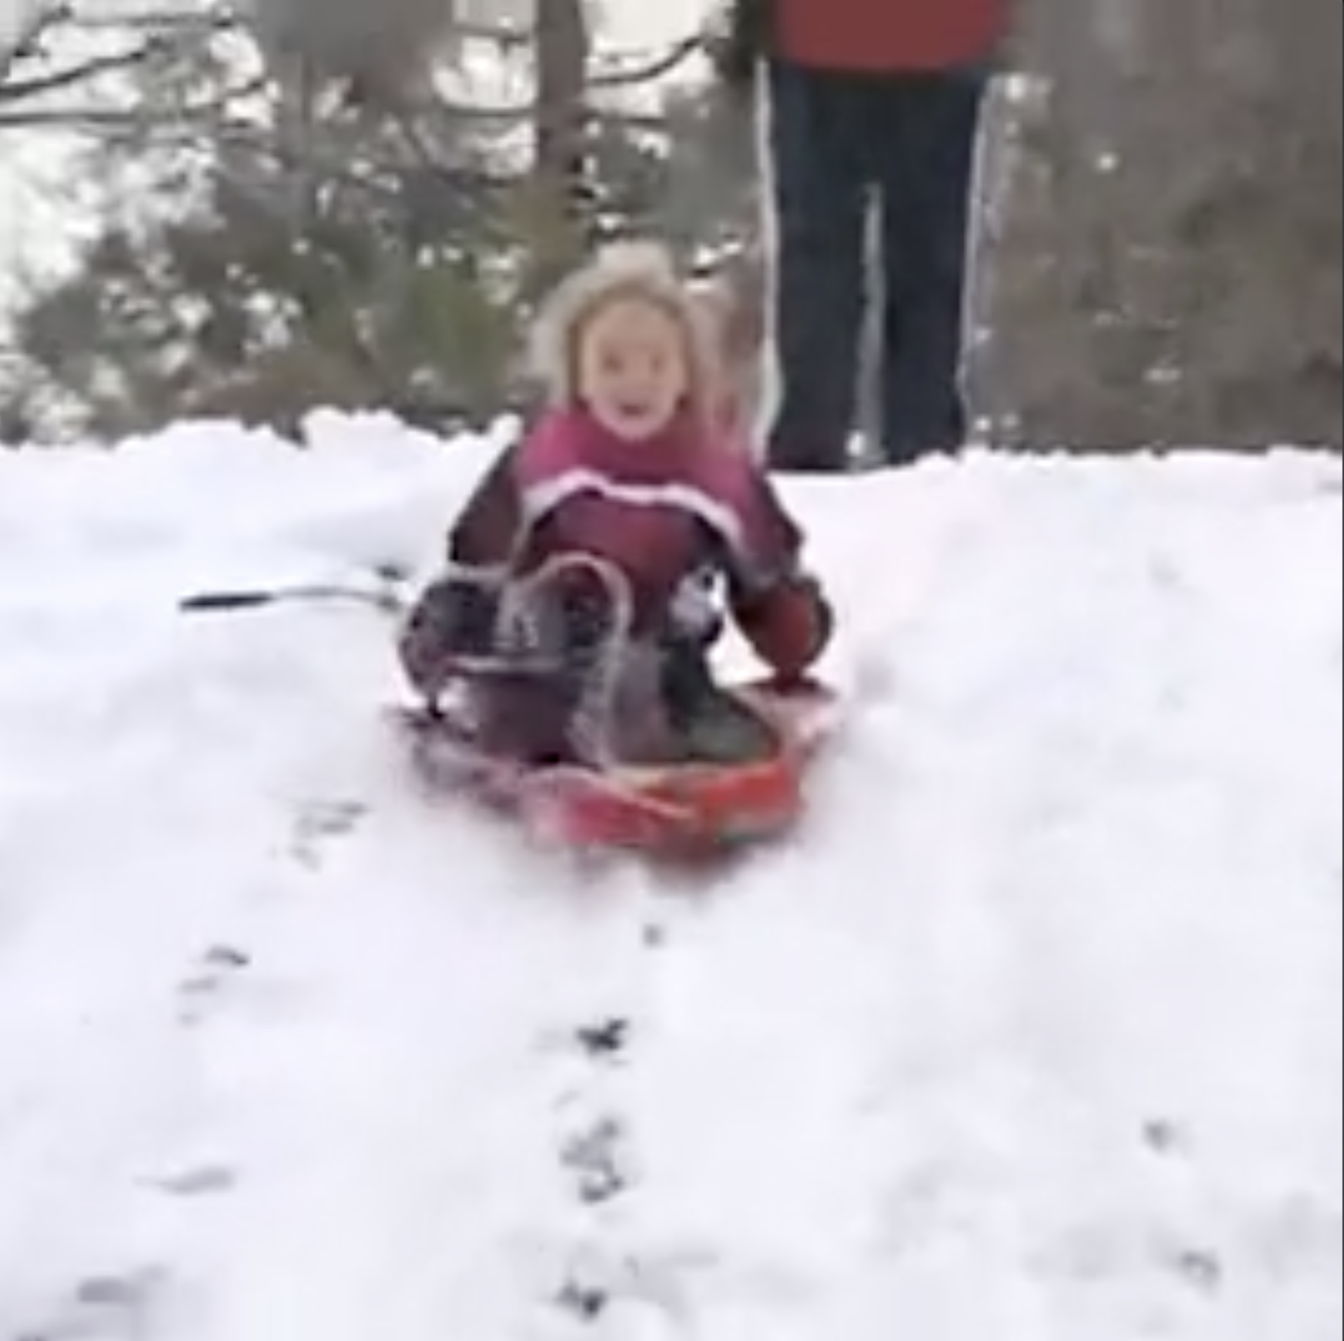
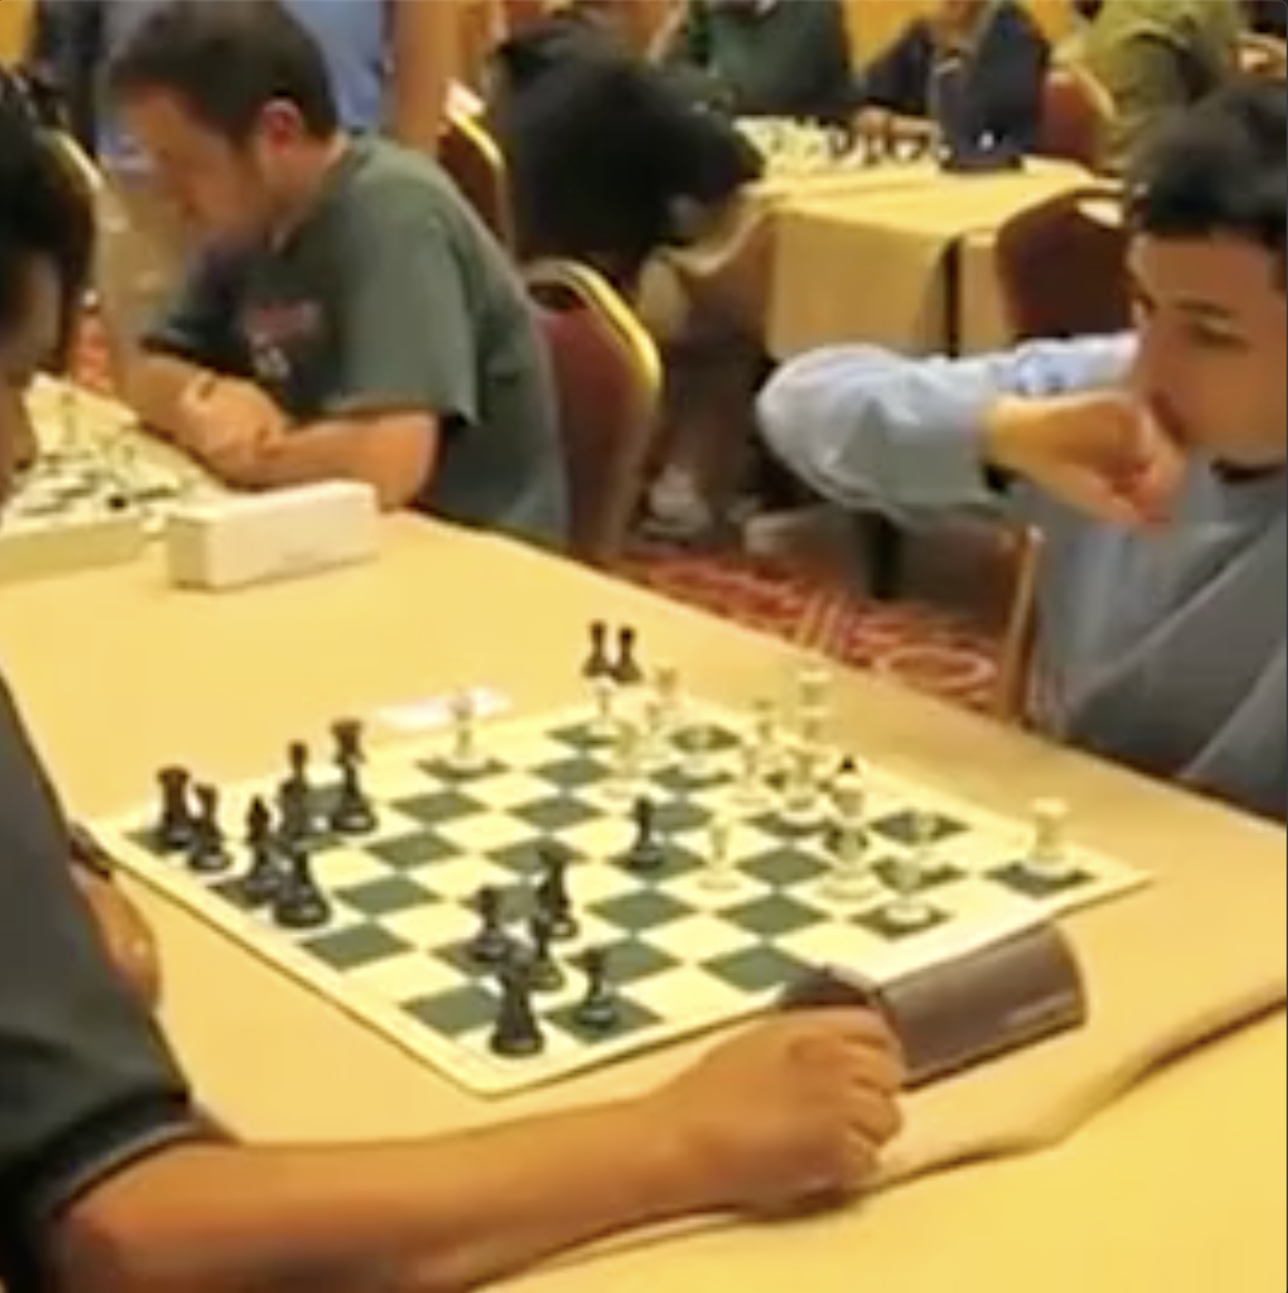
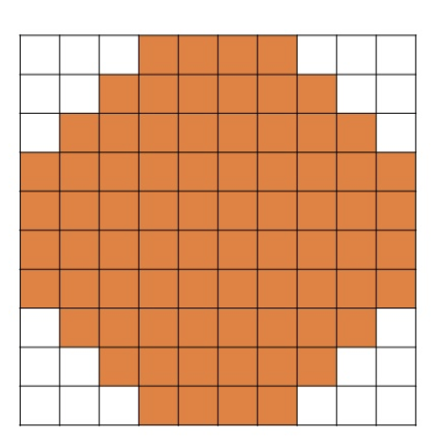
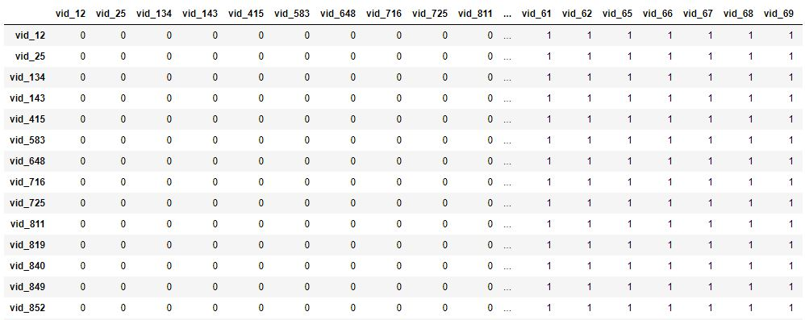
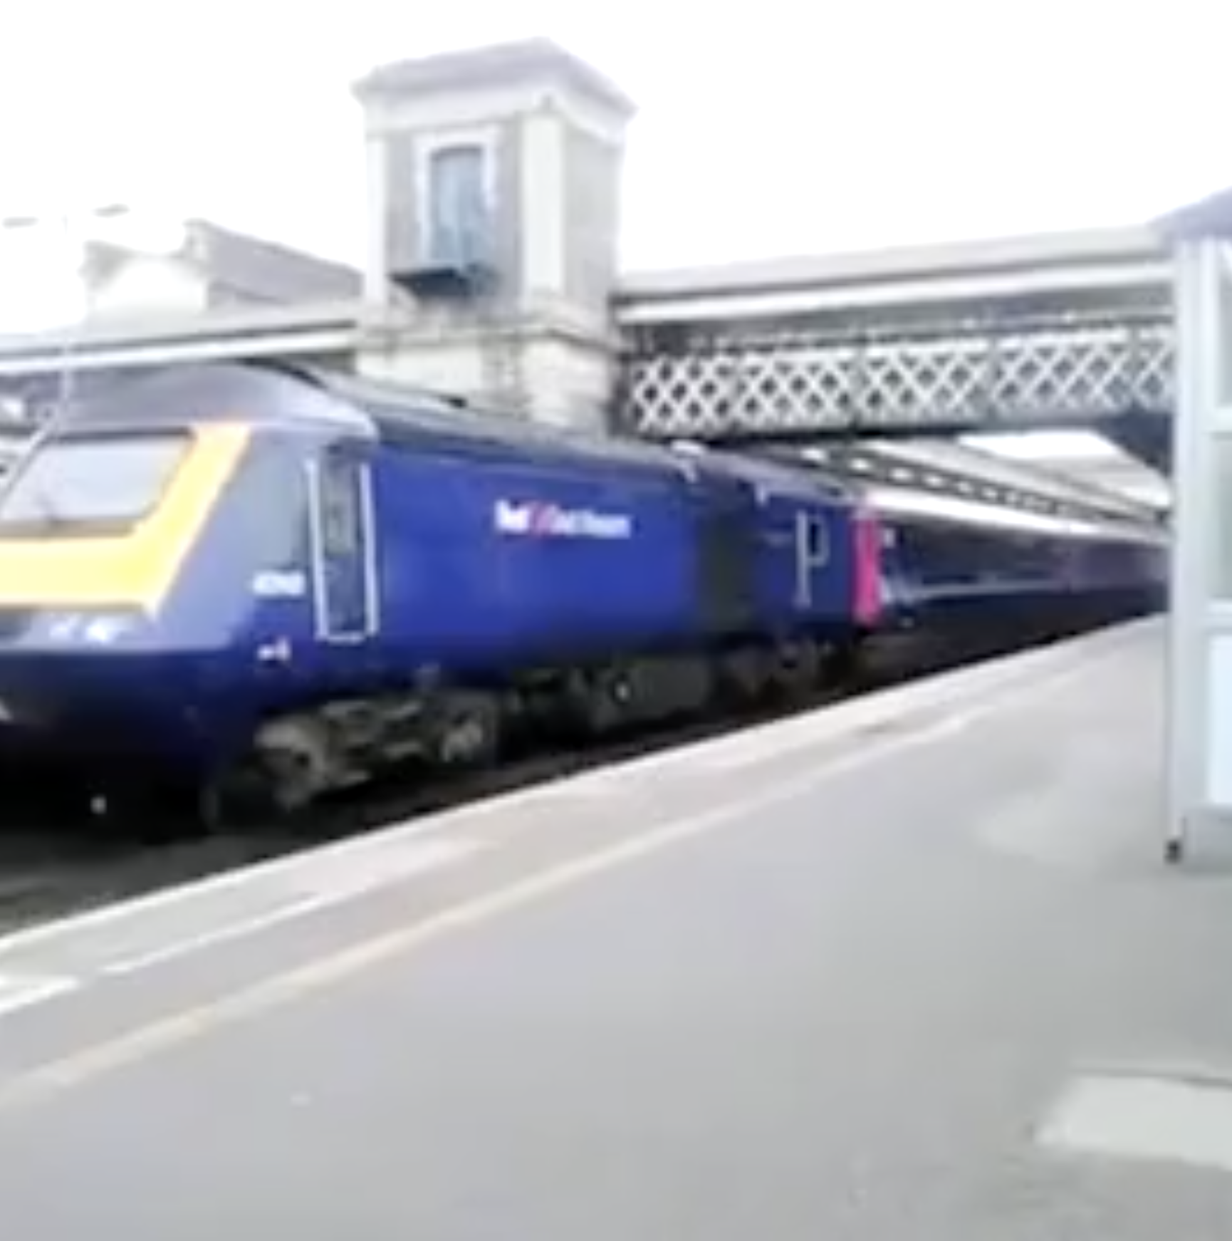

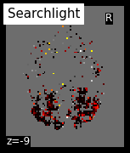
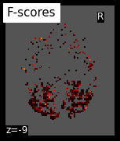
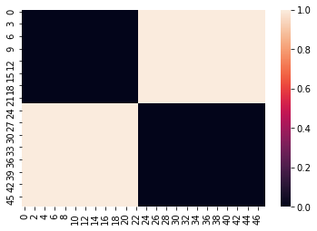
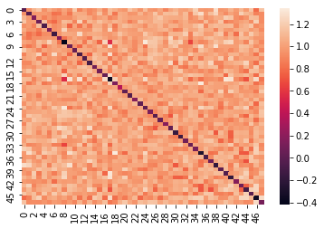
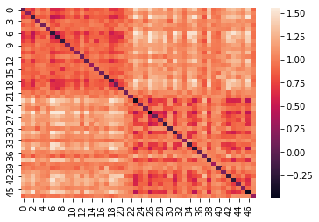
Methodology
Labelling videos & extracting voxel activations
Human (25)
Vehicles (23)
Corresponding voxel activations for 9 brain regions (ROIs)
Computing difference between videos using RDM (same category = 0, different = 1)
Information-based mapping using searchlight analysis
RDM of voxel activations for human vs vehicles videos in different brain regions (visual system)
Scholarly Bears
Semantic Representation of Humans VS Vehicles
Scholarly Bears
Semantic Representation of Humans VS Vehicles
‹#›
‹#›
Notes:
Searchlight: Searchlight analysis produces maps by measuring the information in small spherical subsets (“searchlights”) centered on every voxel; the map value for each voxel thus derives from the information present in its searchlight, not the voxel individually

Slide 4

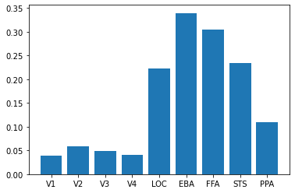
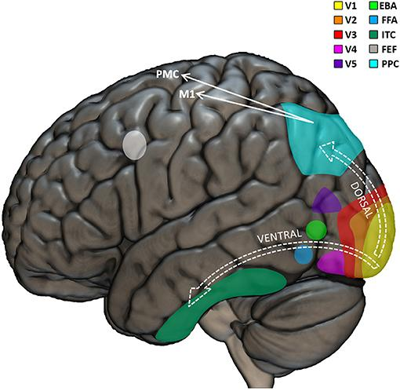
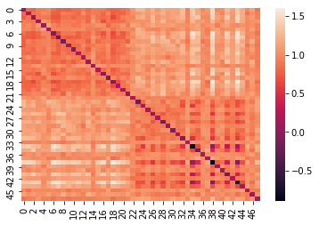
Results and Conclusion
Mean correlation for different regions across subjects
Ground Truth
V1
EBA
FFA
The Wiggly Caterpillars
Scholarly Bears
Semantic Representation of Humans VS Vehicles
Scholarly Bears
Semantic Representation of Humans VS Vehicles
Semantic Representation of Humans VS Vehicles
‹#›
‹#›
‹#›

Slide 5
Results and Conclusion
Searchlight results for the whole brain region
Code: https://github.com/ernest-s/Neuromatch-ScholarlyBears
The Wiggly Caterpillars
Scholarly Bears
Semantic Representation of Humans VS Vehicles
Scholarly Bears
Semantic Representation of Humans VS Vehicles
Semantic Representation of Humans VS Vehicles
‹#›
‹#›
‹#›

Slide 6
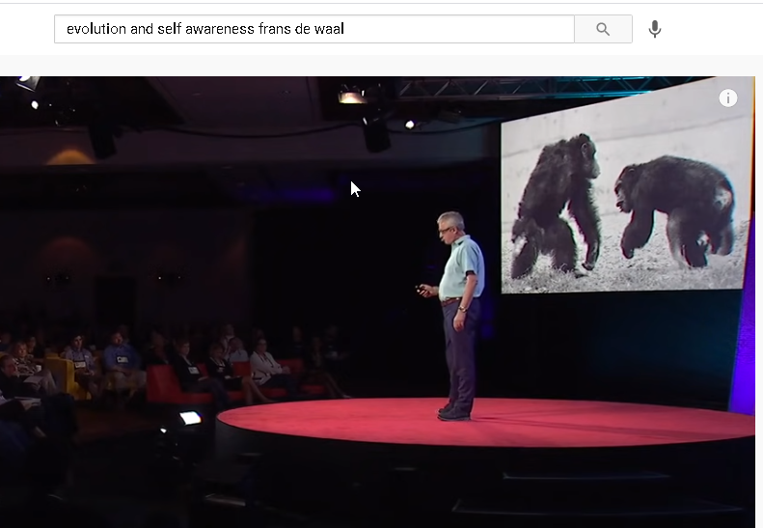
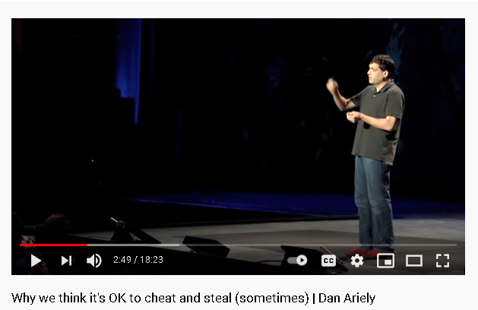
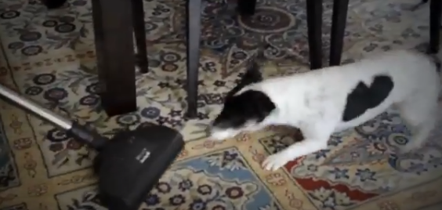
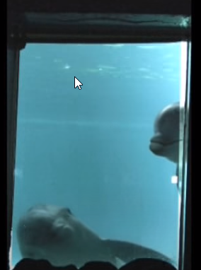
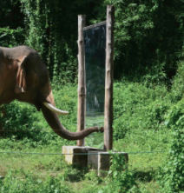

Future Directions
How questions - Semantic Priming
Why questions - Cognition and evolution of the Human Brain
Semantic Representation of Humans VS Vehicles
Scholarly Bears
‹#›
Notes:
There is a concept in psychology called “semantic priming”, where a person's psychology is affected in subtle ways by being exposed to certain words before some other psychological experiment. For example, Daniel Ariely has done research on cheating, and has done psychological experiments where he exposed the subjects to items like the 10 commandments before testing whether people will cheat. One ideas for future research would be to rerun such experiments and measuring the brain to see if you can correlate the semantic priming with fMRI (or other brain measurements) to see if one can add insight into such experiments in a tangible way. In other words, can you "see" semantic priming happening in the brain. And also, can you use that insight to draw conclusions that couldn't otherwise be made?
To give a scale of perceptive cognition in the line of evolutionary brain development, we have on the one hand non-human primates, and other mammals who have varying degrees of cognitive power. Whereas, humans can distinguish animate vs inanimate objects (humans vs vehicles), dogs cannot even tell that a vacuum cleaner isn’t an animate object. Above dogs, on this cognitive scale, would be other primates, but somewhere along the line of evolution humans also learned to recognize themselves in a mirror (self-awareness). Other primates are unable to do this. Elephants and dolphins can match this level of cognition, but can we pinpoint the differences in brains which are self aware vs brains that are not able to recognize themselves in the mirror? To get a better understanding of the mechanism of cognition, it would be good to understand how visual perception in the brain really works.

Slide 7
References
Huth, A. G., Nishimoto, S., Vu, A. T. & Gallant, J. L. (2012). A continuous semantic space describes the representation of thousands of object and action categories across the human brain. Neuron, 76(6), 1210-1224.
Kriegeskorte, N., Mur, M., & Bandettini, P. A. (2008). Representational similarity analysis-connecting the branches of systems neuroscience. Frontiers in systems neuroscience, 2, 4.
Kriegeskorte, N., Goebel, R., & Bandettini, P. (2006). information-based functional brain mapping. Proceedings of the National Academy of Sciences, 103 (10), 3863-3868.
Naselaris, T., Kay, K. N., Nishimoto, S., & Gallant, J. L. (2011). Encoding and decoding in fMRI. Neuroimage, 56(2), 400-410.
Wu, M. C.-K., David, S. V., & Gallant, J. L. (2006). Complete Functional Characterization of Sensory Neurons by System Identification. Annual Review of Neuroscience, 29(1), 477–505.
The Wiggly Caterpillars
Scholarly Bears
Semantic Representation of Humans VS Vehicles
Scholarly Bears
Semantic Representation of Humans VS Vehicles
Semantic Representation of Humans VS Vehicles
‹#›
‹#›
‹#›

Slide 8
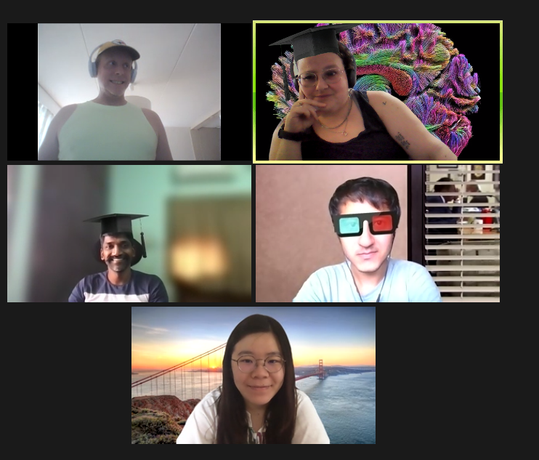
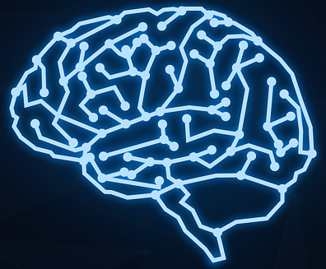
Acknowledgements
Special thanks to:
Pod TA - Tanya Rubinstein
Project TAs - Mo Shahdloo, Aakash Agrawal
Project Mentor - Andrey Chetverikov
Thank you all for listening!
The Wiggly Caterpillars
Scholarly Bears
Semantic Representation of Humans VS Vehicles
Scholarly Bears
Semantic Representation of Humans VS Vehicles
Semantic Representation of Humans VS Vehicles
‹#›
‹#›
‹#›

